Slide 1


HADLEY TECHNOLOGIES
Consulting | Technology | Innovation
www.hadleytech.com
©Hadley Technologies 2019 | Client Confidential

Slide 2

WELCOME TO HADLEY
WHO WE ARE
WHAT WE DO
HOW WE ARE STRUCTURED
WHY TECHNOLOGY
OUR CURRENT KEY PROJECT
OUR KEY PATNERS
WORK WITH HADLEY
CLOSING

Slide 3
Hadley Technologies is a consulting, technology and IT innovation ﬁrm focused on delivering value through technology for businesses operating in sub-Saharan Africa.
We deﬁne success as achieving exceptional results that have a positive and lasting impact on businesses, communities and individuals in our region.
Our clients choose us because we exploit traditional and emerging technologies to ﬁnd solutions that give them competitive advantages in a rapidly changing and challenging business environment.
We lead our clients along their digital transformation journey, combining on-the-ground delivery knowledge with deep technical expertise and a keen eye on next-generation technologies.
Welcome to
Hadley
Technologies

Slide 4



Who We Are
THE PRINICIPALS
KUSUM APPIAH
ISAAC
DANKYI-KORANTENG
ANTHONY DADZIE
Technology, Innovation
Marketing, Strategic Planning
Customer Adoption Strategy, Strategic Planning, Business Development, IT Delivery, Operations
Business Development
Digital Strategy, Technical Architectures, Business Transformation, Software Development, Mobile apps, Data Analytics
Leadership, Business Strategy, Business Development, Negotiation, Communication, Business Transformation

Slide 5
What We Do.
OUR KEY SERVICES
1.
2.
3.
Consulting
IT Infrastructure
INNOVATION
IT Strategy & Operations
Digital Trust & Cyber Security
Delivery and Operations Management
IT Delivery Assurance
Technology Procurement and Service Assurance.
Storage, Networks and Data Centers
Hardware and Virtualization
Devices & Connectivity
Data and Systems Integration.
Software Development
Web Development
Mobile App Development
Digital Transformation
Cloud, Mobile & Connectivity
Business Intelligence and Analytics
Internet of Things (IoT)

Slide 6
How We are Structured.
OUR SERVICE LINES
Hadley Technologies Ltd
IT Infrastructure
IT Consulting
IT Solutions
Administration
Finance
Storage
Project Management
Software Development
HR
Compute
IT Strategy & Delivery
Payment Platforms
Marketing
Networking
Digital Transformation
Mobile Apps
Legal
Devices & Connectivity

Slide 7
Device Growth
250 million smartphone subscriptions in sub-Saharan Africa in 2016
Connectivity
16 billion connected devices globally in 2016
Why
Hadley chose
Technology
Mobility
660 million mobile subscriptions in sub-Saharan Africa in 2016
Data Explosion
36% growth in data traffic on smartphones annually in sub-Saharan Africa
*Ericsson Mobility Report June 2017

Slide 8


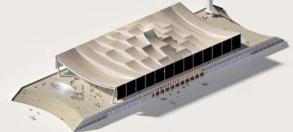
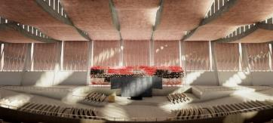
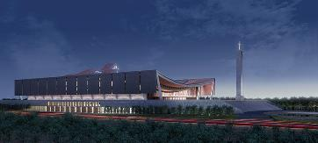
Our Current Key Project.
A SPIRITUAL HOME FOR THE NATION
THE NATIONAL CATHEDRAL OF GHANA
Hadley Technologies was selected as the technology partner for the National Cathedral of Ghana.
We have been tasked with the design, installation and configuration of the cathedral’s technological infrastructure including networking and surveillance. We are also responsible for the cathedral website and both the web-based and mobile donation platforms for the project.

Slide 9










Our Key Partners.
OUR TECHNOLOGY PARTNERSHIPS

Slide 10


WORK
WITH HADLEY

Slide 11

Work With US
Seasoned Professionals
u
What do
you get?
Over 60 years collective experience in the IT and technology sector. We have worked with global organizations, including IBM, Huawei, Ericsson & EMC.
Top reasons to work
with Hadley
Market Insight
H
Navigating the African business environment requires deep local market knowledge – we have successfully developed and delivered solutions across the continent.

Slide 12

Platform Expertise
We excel at developing technology solutions for consumers to access products and services from their phones.
Business Acumen
We are great at commercializing technology solutions to drive profitability and sustainable growth.

Slide 13

Get
In Touch
www.hadleytech.com
info@hadleytech.com
START NOW
13 Oleander Street
East Legon,Accra,
Ghana
Hadley Technologies

Slide 14


OUR IDENTITY
Nkyinkyim | “Twisting”
Dynamic, versatile and adaptable
The ultimate survival trait for any business operating in the rapidly changing and challenging environment that is Africa.

